Slide 1


Graduation and Degree Application Steps

Slide 2


Slide 3
Contents
信息确认、申报毕业 (Information confirmation and Declaration for Graduation): complete the requirements till April 22 (confirm the deadline from your School and supervisor)
论文评阅阶段 (Process of checking the thesis): complete the requirements according to the time arrangement of your School and supervisor
论文查重检测 (Thesis duplicate inspection): before April 27 (confirm the deadline from your School and supervisor)
答辩 (Defense): before June 2 (confirm the time and application deadline from your School and supervisor)
答辩后提交材料阶段 I (Submitting materials after defense (I)): confirm the time arrangement from your School and supervisor
答辩后提交材料阶段 II (Submitting materials after defense (II)): before December 28 (confirm the deadline from your School and supervisor)

Slide 4
信息确认、申报毕业 INFORMATION CONFIRMATION AND DECLARATION FOR GRADUATION Start: 25 of Feburary Complete: till 22 of April (confirm the deadline from your School and supervisor)

Slide 5
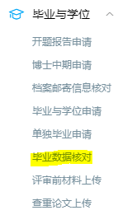
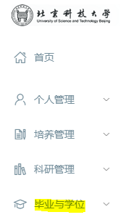
First, Log into
“研究生信息管理系统” (Graduate Information System Management)
http://yjsy1.ustb.edu.cn:8080/pyxx/login.aspx
Second, click on “毕业与学位” (Graduation and Degree)
Third, click on
“毕业数据核对” (Degree data check)
Then fill in all the required information, check, save and submit:

Slide 6
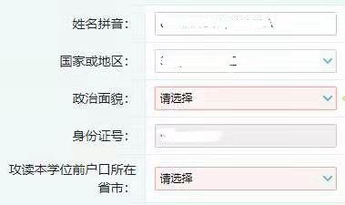
PERSONAL INFORMATION
Student name
Country of birth
Choose the “13|群众” political outlook
Passport number
Choose the “00|其他” option

Slide 7
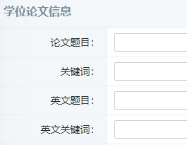
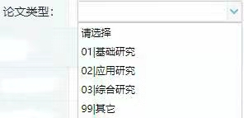
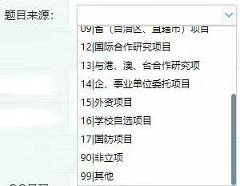
THESIS INFORMATION
THESIS TITLE IN CHINESE
THESIS KEYWORDS IN CHINESE
THESIS TITLE IN ENGLISH
THESIS KEYWORDS IN ENGLISH
THESIS TITLE ’S SOURCE (confirm from your supervisor)
TYPE OF THESIS:
basic research
applied research
comprehensive research
other type

Slide 8
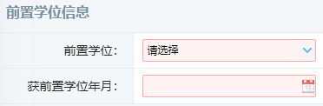


PRE-DEGREE INFORMATION
PRE-DEGREE
PRE-DEGREE AWARDED DATE
PRE-DEGREE FIRST-LEVEL DISCIPLINE/SUBJECT
PRE-DEGREE UNIVERSITY
After filling in the required information on this page, please click the “提交” button to submit (in upper right corner)

Slide 9
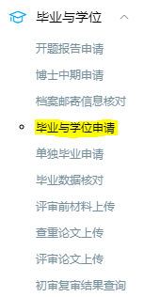
Declaration for graduation
How to fill in the 毕业与学位申请 (Application for graduation and degree) :
First, open the “毕业与学位申请” interface

Slide 10
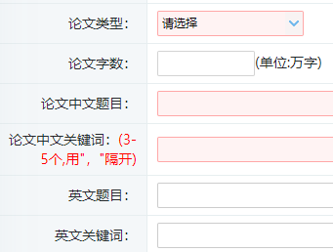
Fill in the thesis information and submit the graduation application after meeting the requirements for graduation. The application for graduation needs to be reviewed by your supervisor in the system, and then reviewed and verified by the Graduate School Training Office.
TYPE OF THESIS:
“基础研究” (basic research),
“应用研究” (applied research),
“综合研究” (comprehensive research),
“其他” (other type)
COUNT OF THESIS WORDS (Unit: ten thousand words)
THESIS TITLE IN CHINESE
CHINESE KEYWORDS (3-5 keywords
separated by "," comma )
THESIS TITLE IN ENGLISH
ENGLISH KEYWORDS

Slide 11

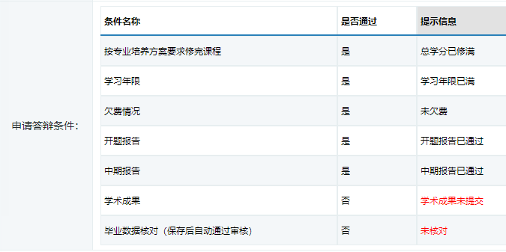
THESIS TITLE ’S SOURCE (confirm from your supervisor)
After filling in the required information, please click on “保存” button to Save. You can not Submit this Application, if any of the items is not in compliance (doesn’t meet the requirements):

Slide 12

After all of the items will be in compliance (do not appear in red), then you can Submit this Application for graduation and degree.
Save
Submit
Next, click on “打印并下载学位材料” (Print and download degree materials) button. Download and print Form 1 “北京科技大学硕士学位申请表” (Application Form for USTB master degree) - 2 copies, then sign it and keep it yourself temporarily.

Slide 13
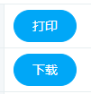

Download the package of Application materials for degree: click on “打印并下载学位材料” (Print and download degree materials).
“Print” button
“Back” button
“Download” button
***All the required materials for application should be downloaded from here.

Slide 14
Contact your supervisor and report your thesis progress plus academic achievements during your study (according to the requirements of your School).
Then you can check the status after reviewing by your supervisor and Training Office on “毕业与学位申请” (Application for graduation and degree) interface. Who fails the verification can not perform the following procedures.

Slide 15
论文评阅阶段 CHECKING THESIS PROCESS Complete the requirements according to the time arrangement of your School and supervisor

Slide 16
Click on “打印并下载学位材料” (Print and download degree materials) button. Download, fill in and print the Form 2 “申请硕士学位指导教师推荐书” (Supervisor’s Recommendation Letter regarding the student applying for Master degree). Ask your supervisor to check and sign this Form.
Fill in and print Form 3 “申请硕士学位论文答辩审核表” (Review Table of the student applying for defense of master degree thesis). This Form to be signed by the person in charge of the Sub-committee, please confirm from your supervisor.

Slide 17
Contact your School to get your Transcript scaled by Graduate School.
Fill in and print the Form 4 “北京科技大学硕士学位论文评阅书” (Evaluation Form of Master degree thesis). Print your thesis (2 copies). The thesis will be reviewed according to the arrangement of your supervisor and School. (This operation is not required if the Training Unit uses the “USTB Master Thesis Review System”, please confirm from your supervisor)

Slide 18
论文查重检测 THESIS duplicate INSPECTION
Complete the requirements before April 27 (confirm the deadline from your School and supervisor)

Slide 19
For uploading the thesis (non-secret thesis) for plagiarism checking, first, click on “毕业与学位” (Graduation and Degree)
The Secret-involved thesis that has been approved (confirm from your supervisor) is excluded from plagiarism checking, please do not upload this thesis for plagiarism inspection.

Slide 20
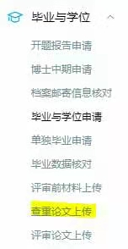
Second, click on
“查重论文上传” (Upload thesis for plagiarism checking)
Third, click on “论文查重申请” (Application for Thesis Duplicate Inspection) (in upper right corner), fill in the required information and upload the thesis.
Plagiarism of the thesis should not be more than 10% (plagiarism % of your own papers in your thesis will not be counted). Confirm this from your supervisor.

Slide 21


(Delete Duplicate Inspection Application)
Application for Thesis Duplicate Inspection
“Back” button
Choose a file to upload
Upload and Submit

Slide 22
When uploading your thesis for duplicate inspection to the system, upload the whole thesis. The thesis should be in PDF or Word format named as “School_Major_Student ID number_Student name” .
After uploading the thesis, inform your supervisor in time and ask him/her to download, review and verify your thesis in the system.
Prepare for your thesis defense ❀

Slide 23
答辩阶段 DEFENSE
Before June 2.
Confirm the defense time and application deadline from your School and supervisor

Slide 24

During the defense, the Form 5 and the Form 6 to be filled in:
1. Defense secretary will fill in and sign the Form 5 “申请硕士学位论文答辩记录表” (Defense record of the student applying for master degree thesis) – 1 copy.
2. Defense secretary will record the vote results. Members of Defense Committee will report decisions and sign the Form 6 – 2 copies.

Slide 25
答辩后提交材料阶段 (I) SUBMISSION OF MATERIALS
AFTER DEFENSE (I)
Complete the requirements according to the time arrangement of your School

Slide 26

Submit the thesis to your School (amount of copies according to the School requirements).
The《北京科技大学学位论文使用授权书》 (Letter of Authorization for the Use of Thesis) should be filled in and signed by the supervisor and the student of the non-secret thesis.

Slide 27
答辩后提交材料阶段(II) SUBMISSION OF MATERIALS
AFTER DEFENSE(II)
Complete the requirements before December 28 (confirm the deadline from your School and supervisor)

Slide 28
Upload the full electronic-version of the thesis in PDF format to the system: “研究生信息管理系统 (Graduate Information System Management) – 毕业与学位 (Graduation and Degree) – 上传正式论文 (Upload Formal Thesis)”. The thesis should include the cover page of the thesis, the signatures of the student and the supervisor. It is used by the Degree Committee to discuss degree awarding and to provide it to CNKI after graduation.
(Except for the secret-involved theses that have been approved)

Slide 29

Happy graduation！

